Slide 1
EAP With a Thousand Faces:
Transitions and Tribulations in the Academic Essay
Alex Gooch
Durham University

Slide 2
Why is the academic essay structured in the way it is? Why does it have the features it has?

Slide 3
Why is the academic essay structured in the way it is? Why does it have the features it has?
Perhaps the structure & features of the academic essay correspond to a ‘deeper’ narrative structure.

Slide 4
I’ll talk about
the narrative structure in question

Slide 5
I’ll talk about
the narrative structure in question
how this corresponds to features of the academic essay

Slide 6
I’ll talk about
the narrative structure in question
how this corresponds to features of the academic essay
my attempts to make use of this in the EAP classroom

Slide 7
Heroic quest narrative.
Possibly the oldest narrative structure in the world.
Epic of Gilgamesh (Mesopotamia, 2,000 – 1,000 BCE)

Slide 8
Different ‘maps’ of the heroic quest narrative:
- Campbell, The Hero with a Thousand Faces (1st pub. 1949) – 17 stages
- Christopher Vogler (Lion King) – 12 stages
- Dan Harmon (Community, Rick and Morty) – 8 stages

Slide 9
Different ‘maps’ of the heroic quest narrative:
- Campbell, The Hero with a Thousand Faces (1st pub. 1949) – 17 stages
- Christopher Vogler (Lion King) – 12 stages
- Dan Harmon (Community, Rick and Morty) – 8 stages
I present a simplified version – 6 stages.

Slide 10
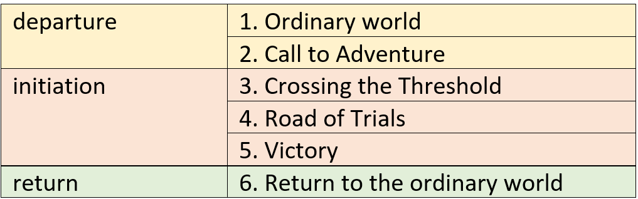
The Heroic Quest Narrative (for example, Jack and the Beanstalk):

Slide 11
How is this relevant to academic essay-writing?
Has been used to model the process of essay-writing
“…the struggles of academic writing are not dissimilar to the struggles associated with any journey into the unknown, and using the ‘hero’s journey’ as a framework for assisting students’ writing processes could be a helpful way for both students and their supervisors.”
(Moore 2013: 207)

Slide 12
I suggest that the hero’s journey describes the essay itself (cf Houslay 2016).
The skilful essay writer:
- organises his/her experience of research and thinking into a coherent heroic journey narrative.
- guides the reader through the same ‘heroic journey’.

Slide 13
I suggest that the hero’s journey describes the essay itself (cf Houslay 2016).
The skilful essay writer:
- organises his/her experience of research and thinking into a coherent heroic journey narrative.
- guides the reader through the same ‘heroic journey’.

Slide 14
I suggest that the hero’s journey describes the essay itself (cf Houslay 2016).
The skilful essay writer:
- organises his/her experience of research and thinking into a coherent heroic journey narrative.
- guides the reader through the same ‘heroic journey’.

Slide 15
I suggest that the hero’s journey describes the essay itself (cf Houslay 2016).
The skilful essay writer:
- organises his/her experience of research and thinking into a coherent heroic journey narrative.
- guides the reader through the same ‘heroic journey’.

Slide 16
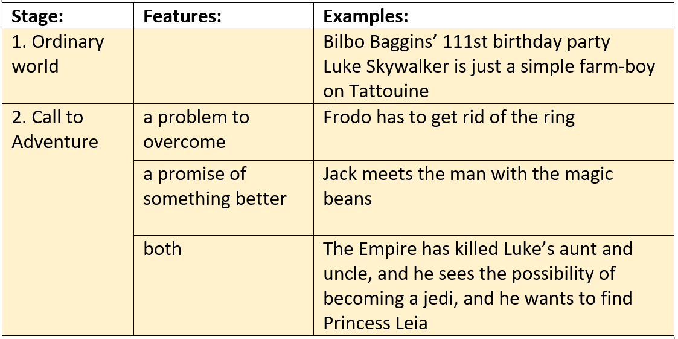
Departure:

Slide 17
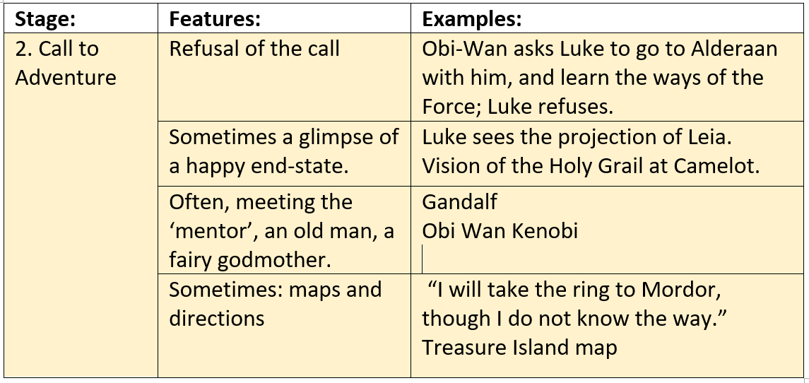
Departure (continued):

Slide 18
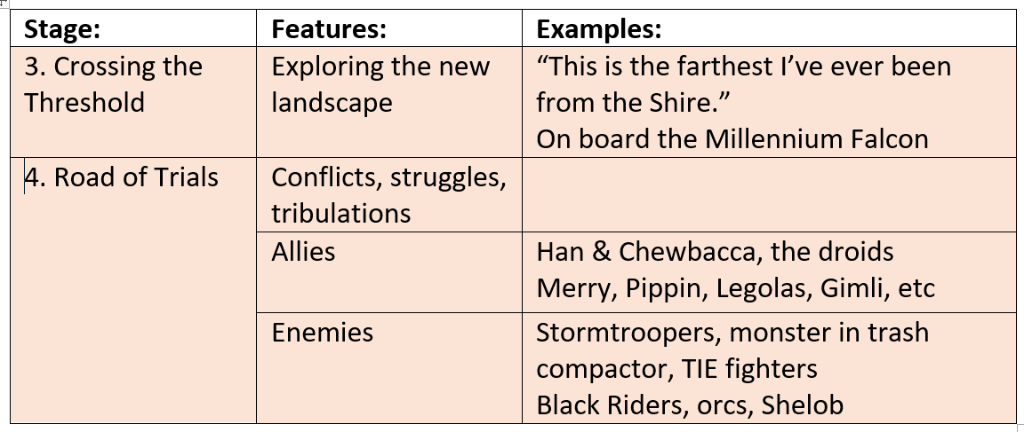
Initiation:

Slide 19
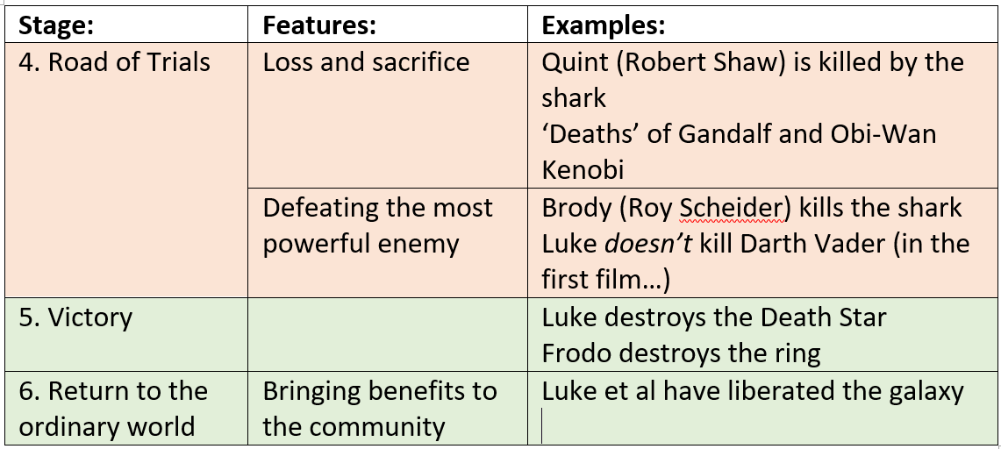
Initiation (Continued); Return:

Slide 20
How does this relate to academic writing?

Slide 21
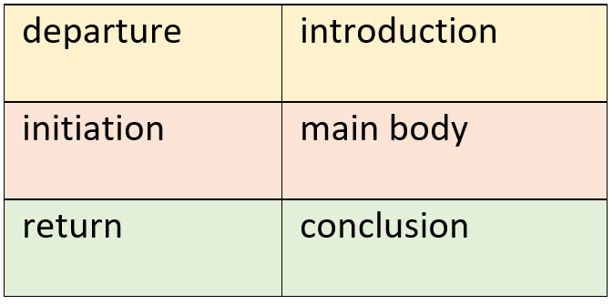
How does this relate to academic writing?

Slide 22
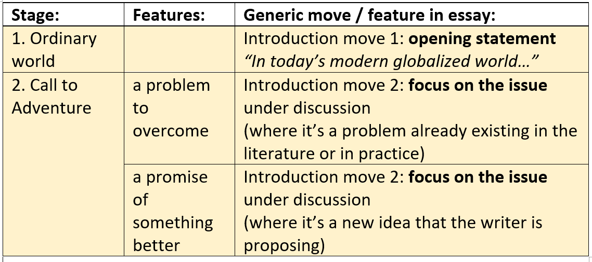
In a little more detail:

Slide 23
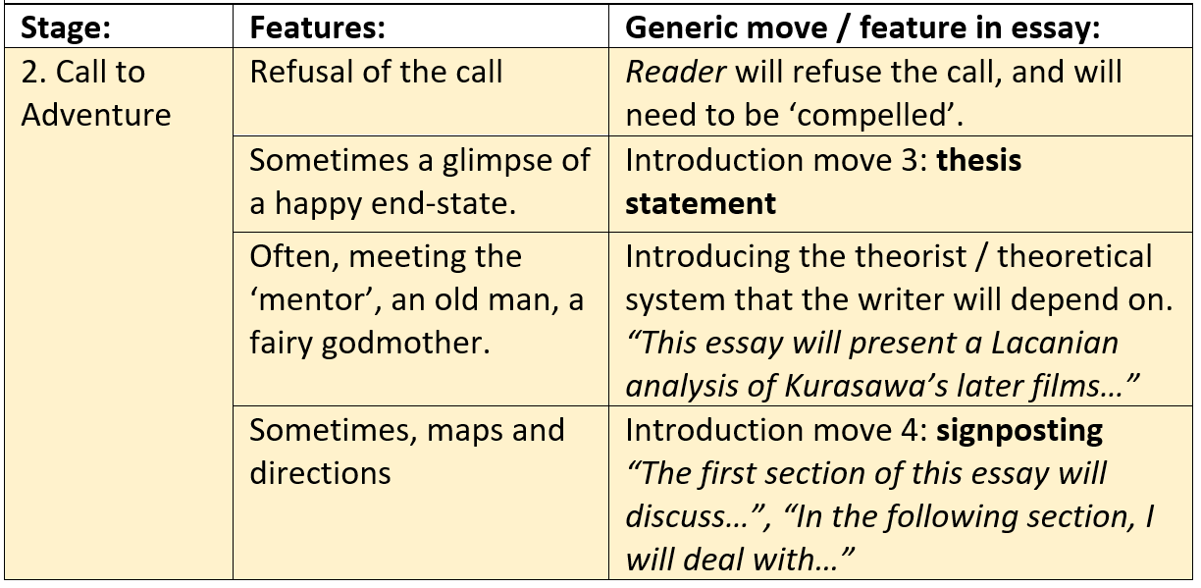

Slide 24
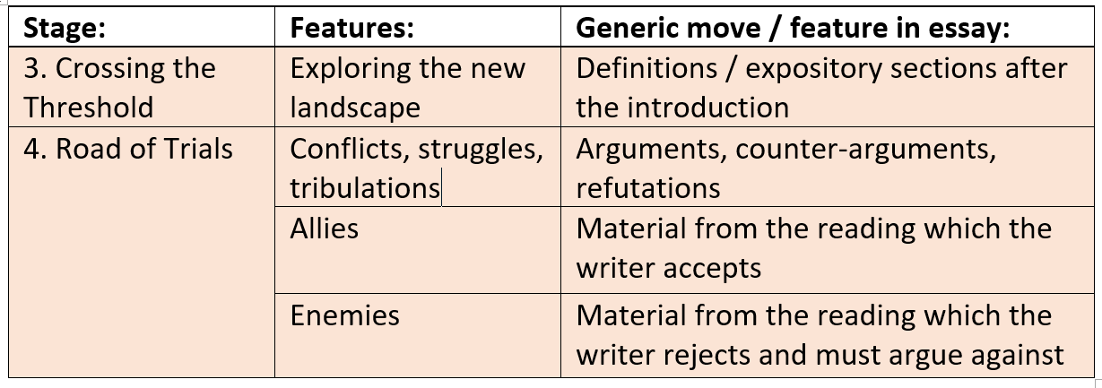

Slide 25
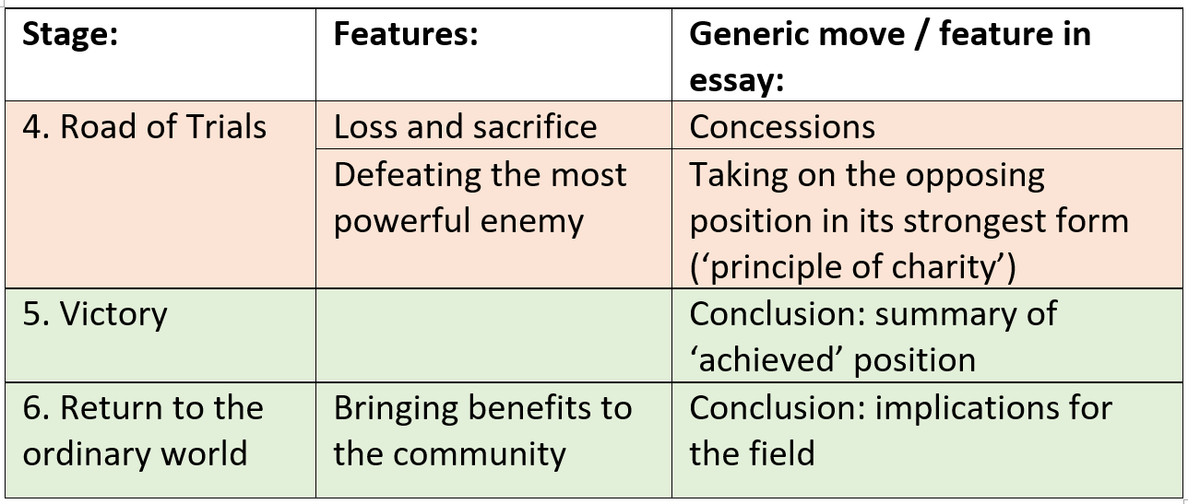

Slide 26
If this is persuasive…

Slide 27
If this is persuasive…
A successful essay may be successful in part because it has satisfied the reader’s narrative expectations.

Slide 28
If this is persuasive…
A successful essay may be successful in part because it has satisfied the reader’s narrative expectations.
An essay as an adventure, rather than an act of ‘production’.

Slide 29
Could all this be useful in the classroom?

Slide 30
Could all this be useful in the classroom?
I tried to create some materials (‘Harry Potter and the Art of Essay-Writing’).

Slide 31
Could all this be useful in the classroom?
I tried to create some materials (‘Harry Potter and the Art of Essay-Writing’).
1st Harry Potter movie isn’t a heroic narrative.

Slide 32
Could all this be useful in the classroom?
I tried to create some materials (‘Harry Potter and the Art of Essay-Writing’).
1st Harry Potter movie isn’t a heroic narrative.
I couldn’t watch the other Harry Potter movies.

Slide 33
Could all this be useful in the classroom?
I tried to create some materials (‘Harry Potter and the Art of Essay-Writing’).
1st Harry Potter movie isn’t a heroic narrative.
I couldn’t watch the other Harry Potter movies.
I didn’t come up with another movie.
If anyone else wants to try, please let me know how it goes!
alexander.gooch@durham.ac.uk

Slide 34
Campbell, Joseph (1968) The Hero With a Thousand Faces (2nd ed), Princeton NJ: Princeton University Press
DePorres, Daphne & Roland E, Livingstone (2016) ‘Launching New Doctoral Students: Embracing the Hero’s Journey’ https://absel-ojs-ttu.tdl.org/absel/index.php/absel/article/view/3024 accessed 2/7/20
Harmon, Dan (undated) ‘Story Structure 102: Pure, Boring Theory’ https://channel101.fandom.com/wiki/Story_Structure_102:_Pure,_Boring_Theory accessed 2/7/20
Houslay, Tom (2016) ‘Applying the Story Circle to Academic Writing’, https://tomhouslay.com/2016/02/05/applying-the-story-circle-to-academic-writing/ accessed 2/7/20
Moore, Sarah (2013) ‘The Hero’s Journey’: Paying Attention to the Emotional Aspects of Academic Writing, and Making Meaning from its Ups, Downs and Paradoxes, in Donnelly, R, Dallat, J & Fitzmaurice M (2013), Supervising and Writing a Good Undergraduate Dissertation, p.207, https://books.google.co.uk/books?id=x7IeDgAAQBAJ&pg=PA207&lpg=PA207&dq=%22joseph+campbell%22+%22academic+writing%22&source=bl&ots=7ByICwJ2CN&sig=ACfU3U0dIduMzxOW3usxa0vCiaPtzSA00w&hl=en&sa=X&ved=2ahUKEwjy_Ne_h5LoAhXMEcAKHS1gCgc4ChDoATAEegQIChAB#v=onepage&q=%22joseph%20campbell%22%20%22academic%20writing%22&f=false accessed 2/7/20
Regalado, Mariana, Helen Gorgas & Matthew J Burgess (2017) ‘Choose Your Own Adventure: The Hero’s Journey and the Research Process’, https://academicworks.cuny.edu/cgi/viewcontent.cgi?article=1128&context=bc_pubs accessed 2/7/20
Vogler, Christopher (2007) The Writer’s Journey: Mythic Structure for Writers (3rd edition), Michael Wiese Productions, Studio City CA

