Slide 1
Chinese e-dictionaries what audiences are they intended for?
Yan Yan Yeung
Hilary Nesi

Slide 2
In China, few EFL learners use print dictionaries
Ciba and Youdao are
the most popular
the most highly rated by Chinese researchers
Some popular electronic dictionaries:
    Youdao
    Jinshanciba / Kingsoft Powerword (a.k.a Ciba)
    Baidu
    Babylon
    Bing
Ciba has more than 100 million users
Youdao has 400 to 700 million users

Slide 3
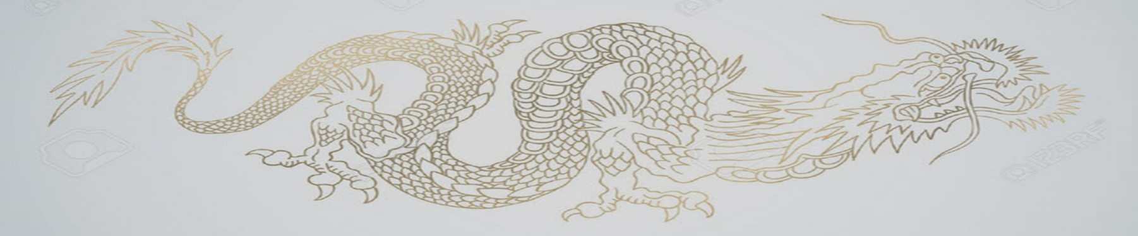
But…..
Ciba and Youdao are developed by software companies, not lexicographers
Information is incomplete, and unreliable
Dictionary sources are not clearly identified, e.g. "Oxford", "Webster“, "Collins“(and may be out of print)
It’s not clear who they are intended for
the interfaces are in Chinese (even in the international versions)
references to Gaokao, CET4, CET6 etc. suggest a focus on mainland Chinese EFL students
  Chinese academics focus on the wording of examples (as a showcase for the Chinese language)

Slide 4
Ciba
"the world’s largest learner’s dictionary" (Gao 2013)
Contains:
141 dictionaries – default is bilingual ‘common’ dictionary
4.5 million+ words collected from the internet (Microsoft Store 2019)
5 million+ bilingual examples
Not clear whether these figures refer to dictionary entries

Slide 5

Youdao
Developed by NetEase, an IT company
Contains:
An unspecified number of monololingual and bilingual dictionaries
Default is bilingual ‘simple’ dictionary
37 million+ entries and 23 million examples (Wang 2019)
650,000+ English words, 590,000+ Chinese words
"Internet definitions" enriched by internet data and the Baidu encyclopedia
Looks like an impossibly high number!

Slide 6
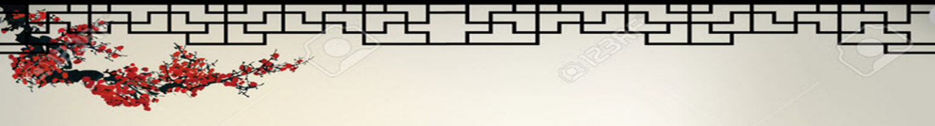

The number of words and phrases is greatly inflated by including:
separate entries for each derivation and inflection
very rare, unattested and misspelled words

Slide 7
The Ciba and Youdao Apps
  Free functions:
  access to monolingual, bilingual, bilingualised and multilingual dictionaries
  examples extracted from the internet
  British and American English audio and IPA
  audio translation
  translations from text in photos, screenshots etc.
  exam preparation - level selected during set-up
    vocabulary lists, past papers, reading, listening, and speaking practice
  personalised vocabulary notebooks
  daily edits (news stories, fun facts etc)
  + subscription only:
  Online tutorial courses
  Bilingual books and audio books (Jinshanciba)
  Member zone (unlimited access to additional functions)

Slide 8
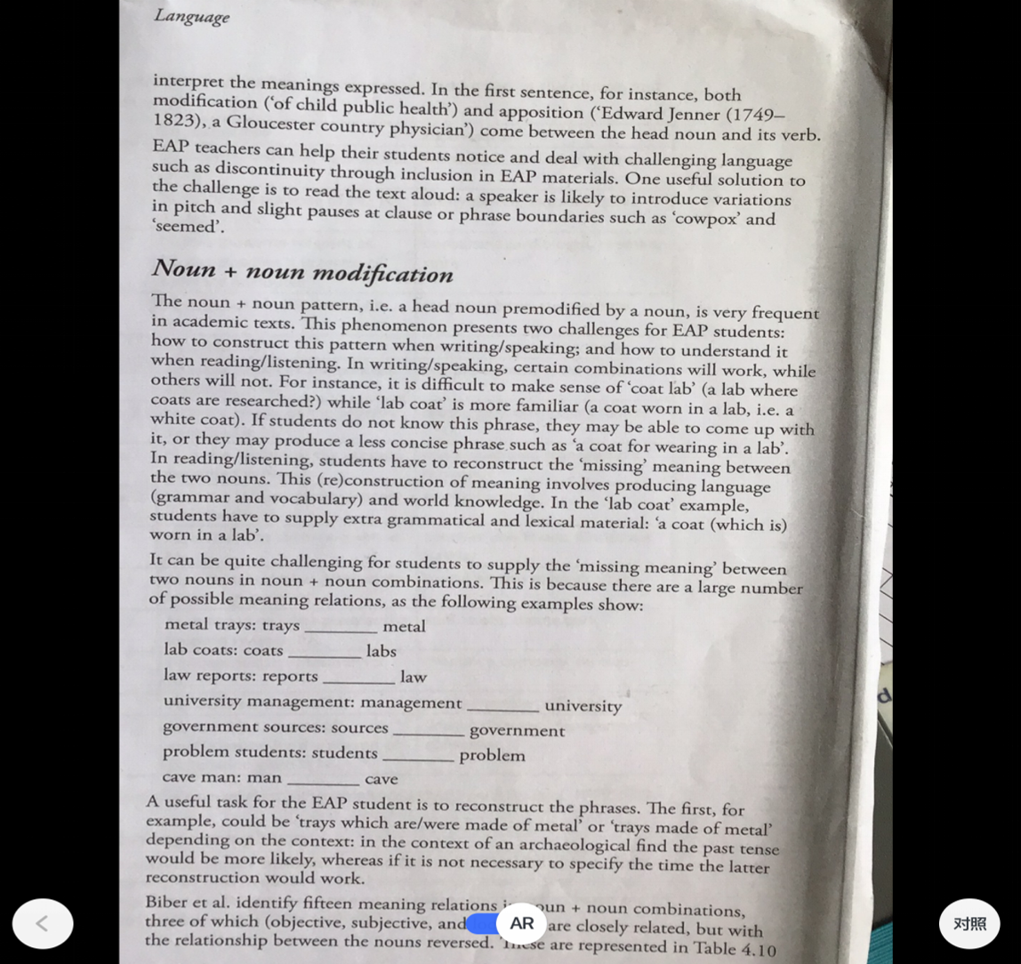

Slide 9
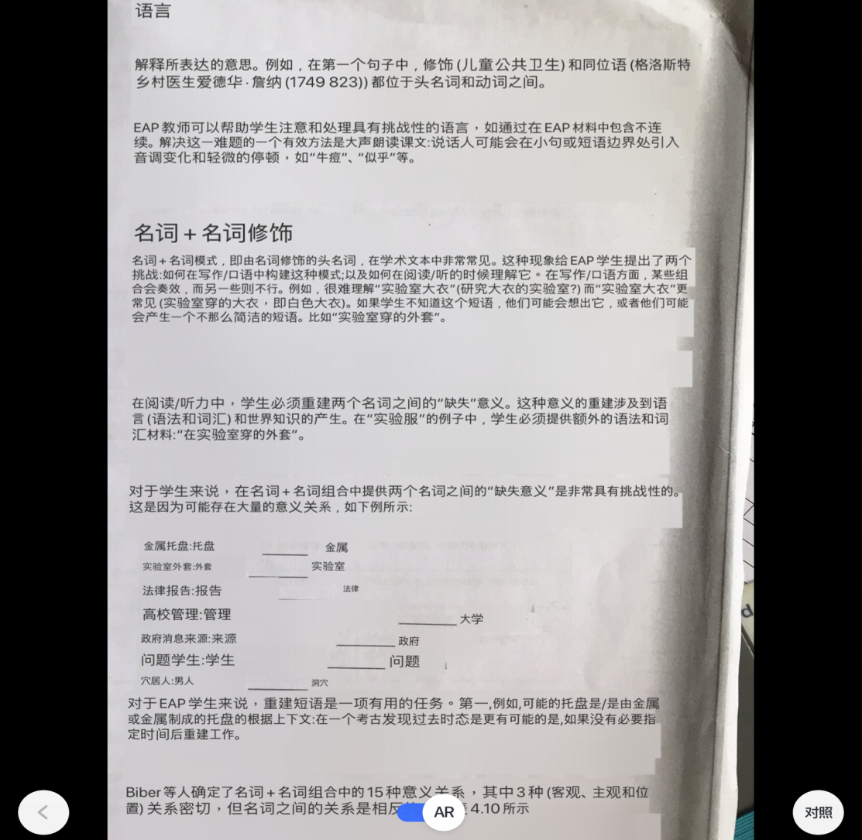
The Chinese translation is not entirely comprehensible

Slide 10
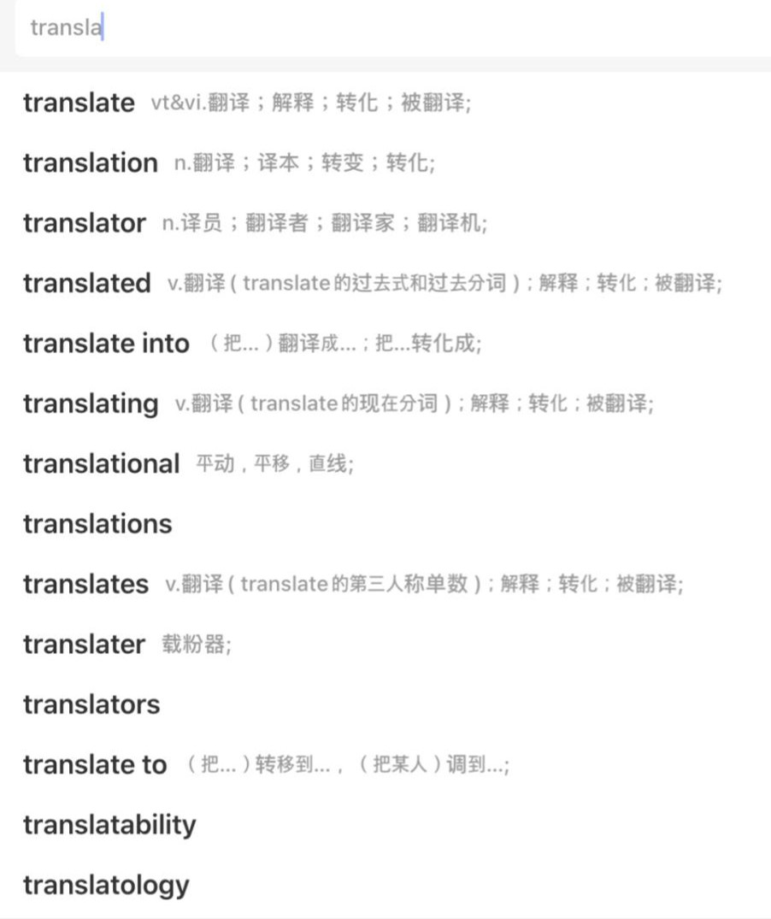
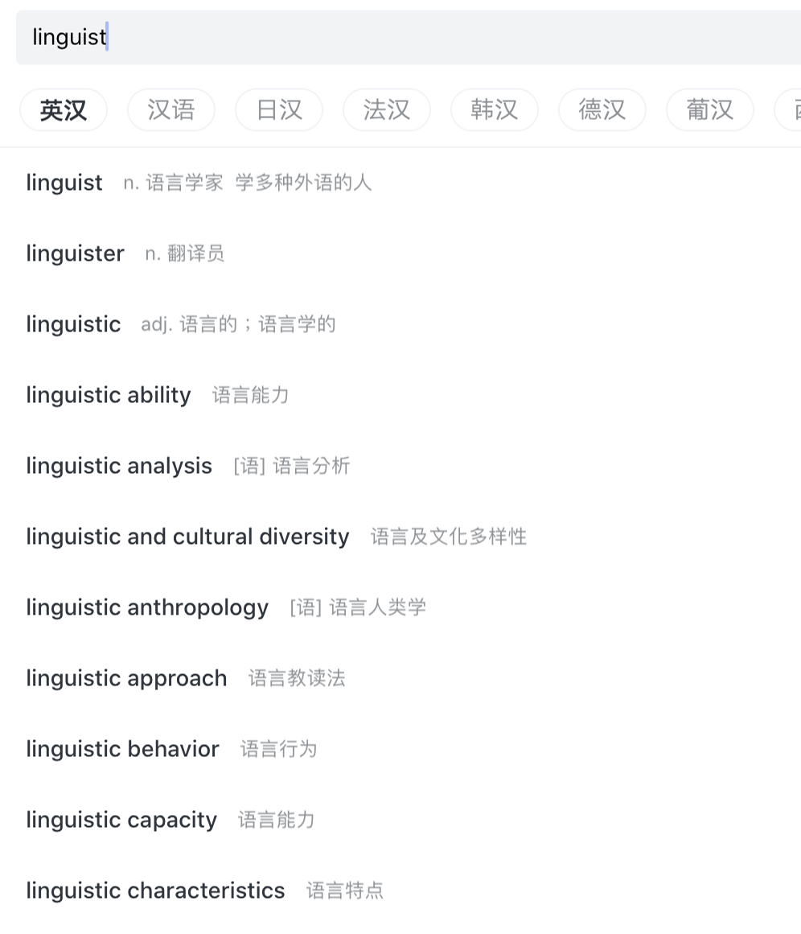
Examples of entries for unattested words in Youdao and Ciba (in menus below “Linguist” and “Translate”)
Linguister (definition: a translator)
Linguistician (definition: a linguist)
Linguistical
Linguistry (definition: knowledge in linguistics)
Translational
Translative
Translatology
Translatory
Claims that these occur in CET past papers and/or online

Slide 11
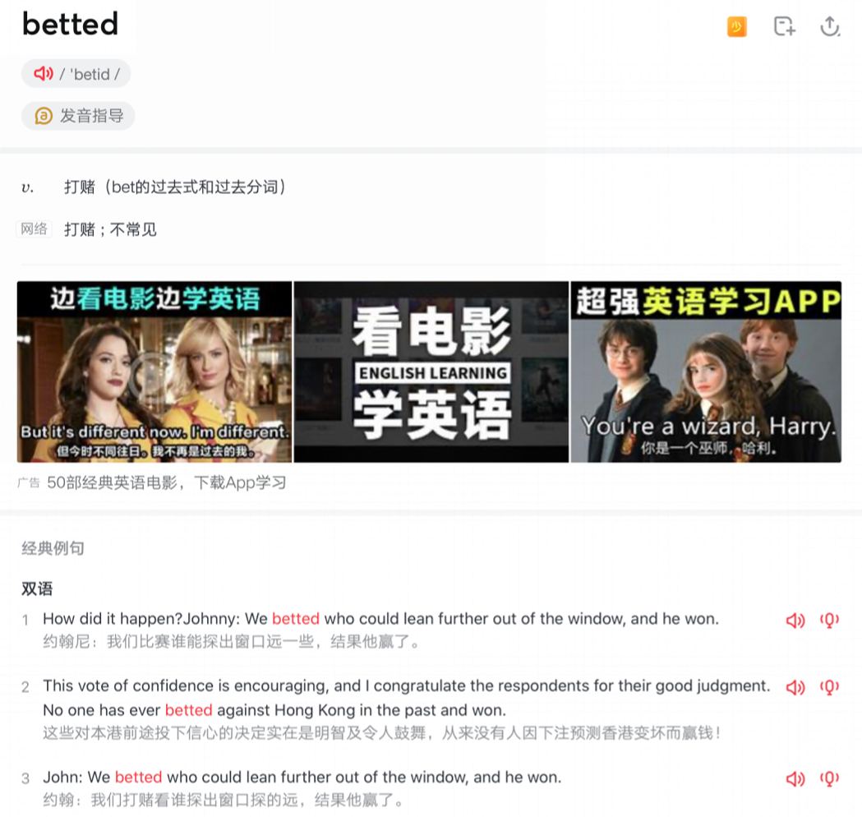
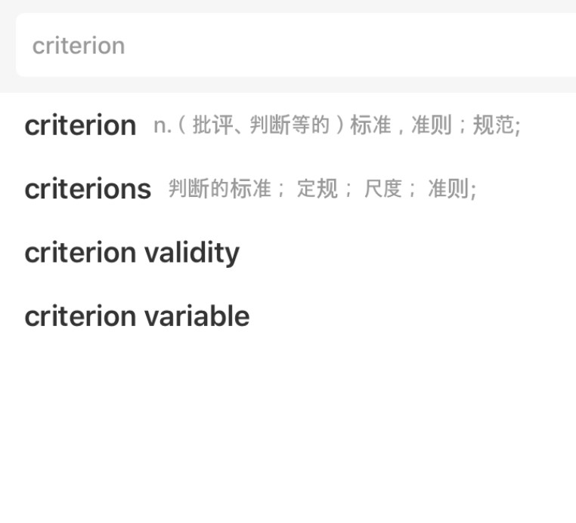
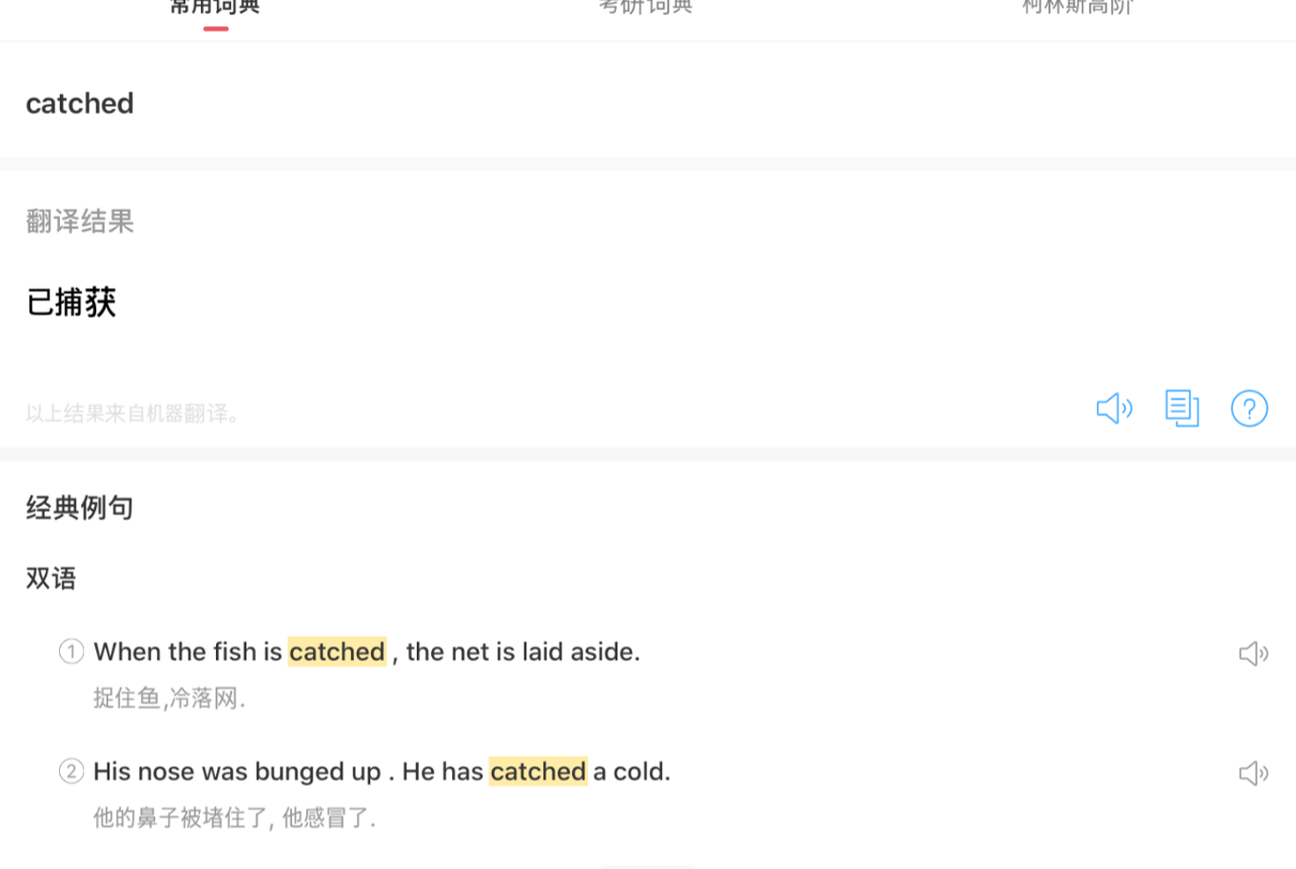
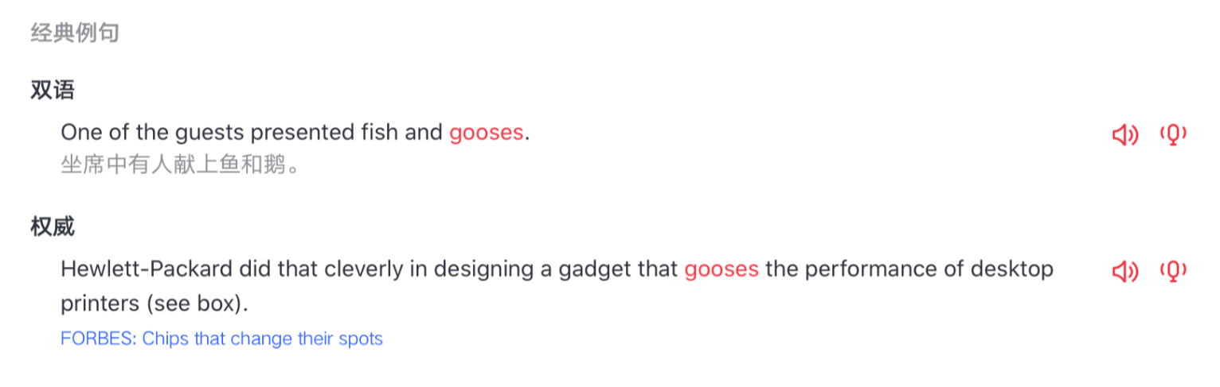
Morphological errors
e.g.
Arised
Awaked
Breaked
Breaken
Beated
Betted
Catched
e.g.
oxe, oxes
gooses ,geeses
sheeps
criterias, criterions
Some of these have their own entry, and some appear in examples.

Slide 12
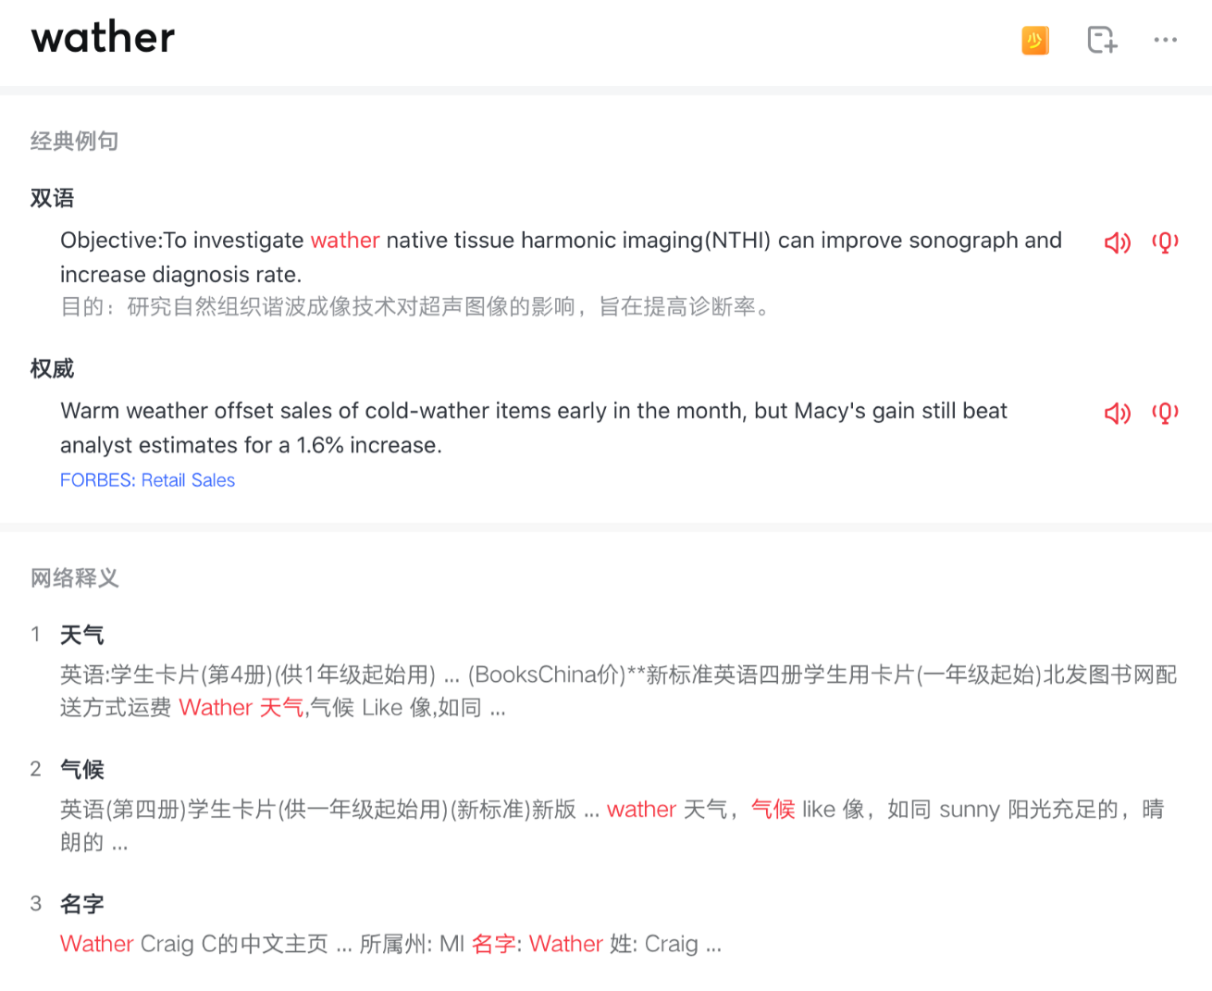
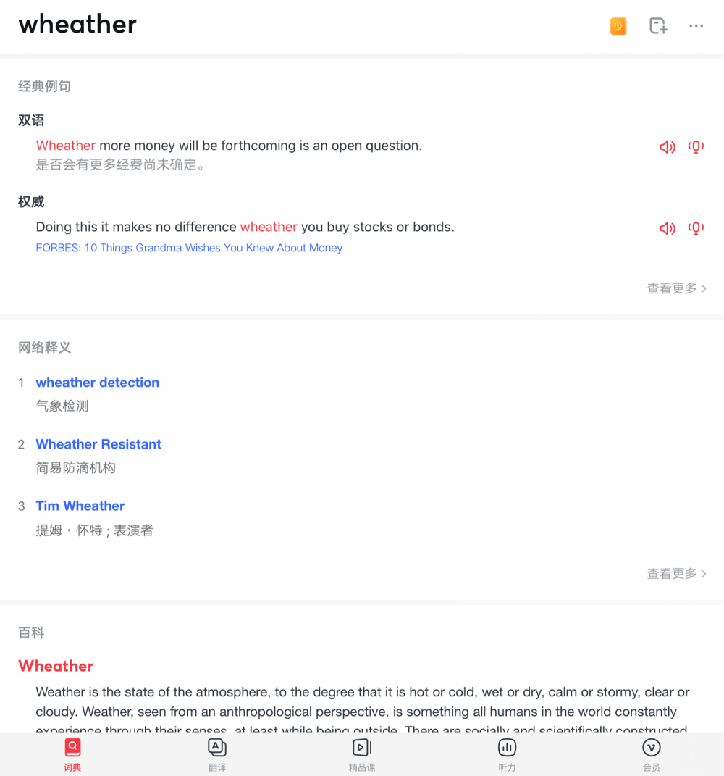
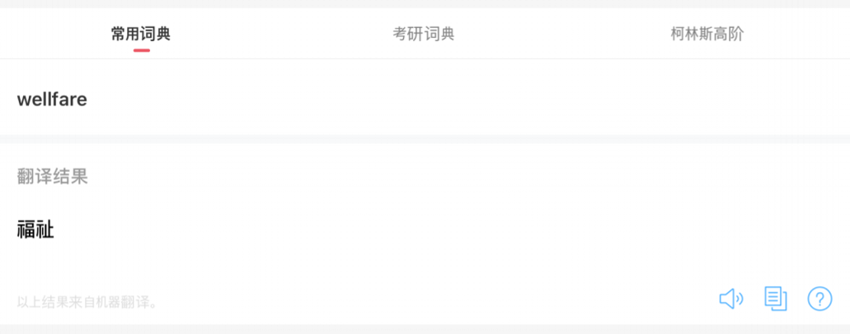
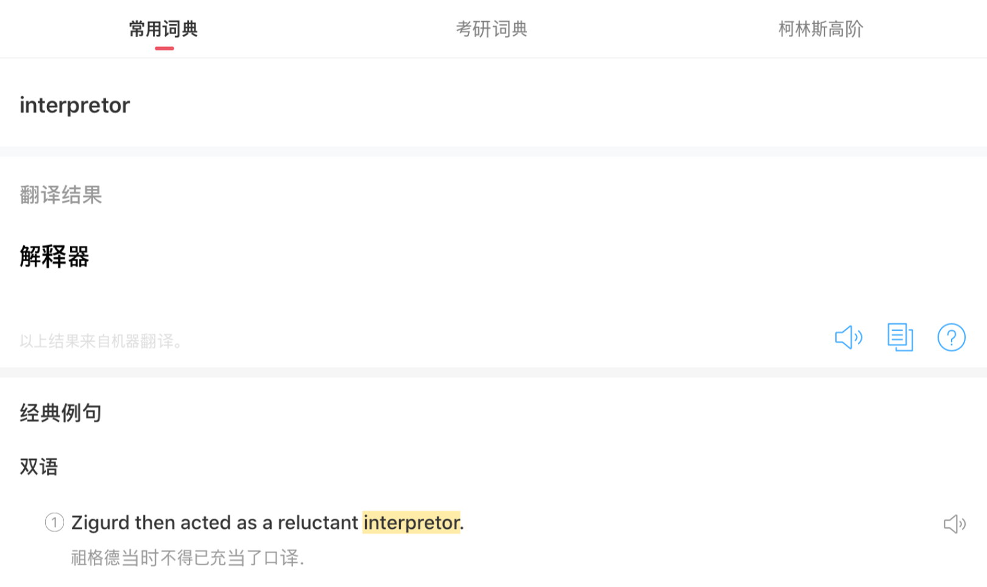
Spelling errors
e.g.
Translater
Interpretor
Imparative
Gaurantee
Wellfare, wealfare
Welth, welthy
Simulteneous, simultanous
Wheather, wather
Modle, modell
Motality (mortality)

Slide 13
Why these problems?
Desire to increase the word count – so these are the largest dictionaries in the world
Use of old dictionaries / technical glossaries
Scanning errors when converting old print dictionaries
Random selection from internet sources
Automatic translation errors
Automatic speech to text transcription errors

Slide 14
The dictionaries are not very useful for EAP learners!
They may serve the purposes of Chinese EFL learners in China who have to pass high-stake exams
Unacceptable forms might appear in Chinese exams (CET papers are given as sources for some of them)
It looks as if there is another audience – not learners of English!
But their main appeal for Chinese users is that they are
very big, very high-tech, and therefore a source of pride:
“made in China, made for China”
Very little academic criticism of these dictionaries in China, and only concerning the quality of the Chinese translations of English usage –
are they poetic enough in Chinese?

Slide 15

Conclusion
Thanks for listening!

