Slide 1
ESAP: conceptual structures & subject specific lexis
Neil.Allison@glasgow.ac.uk

Slide 2
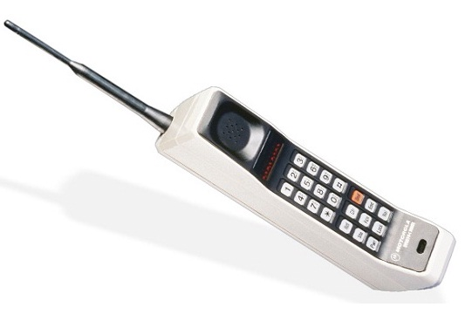
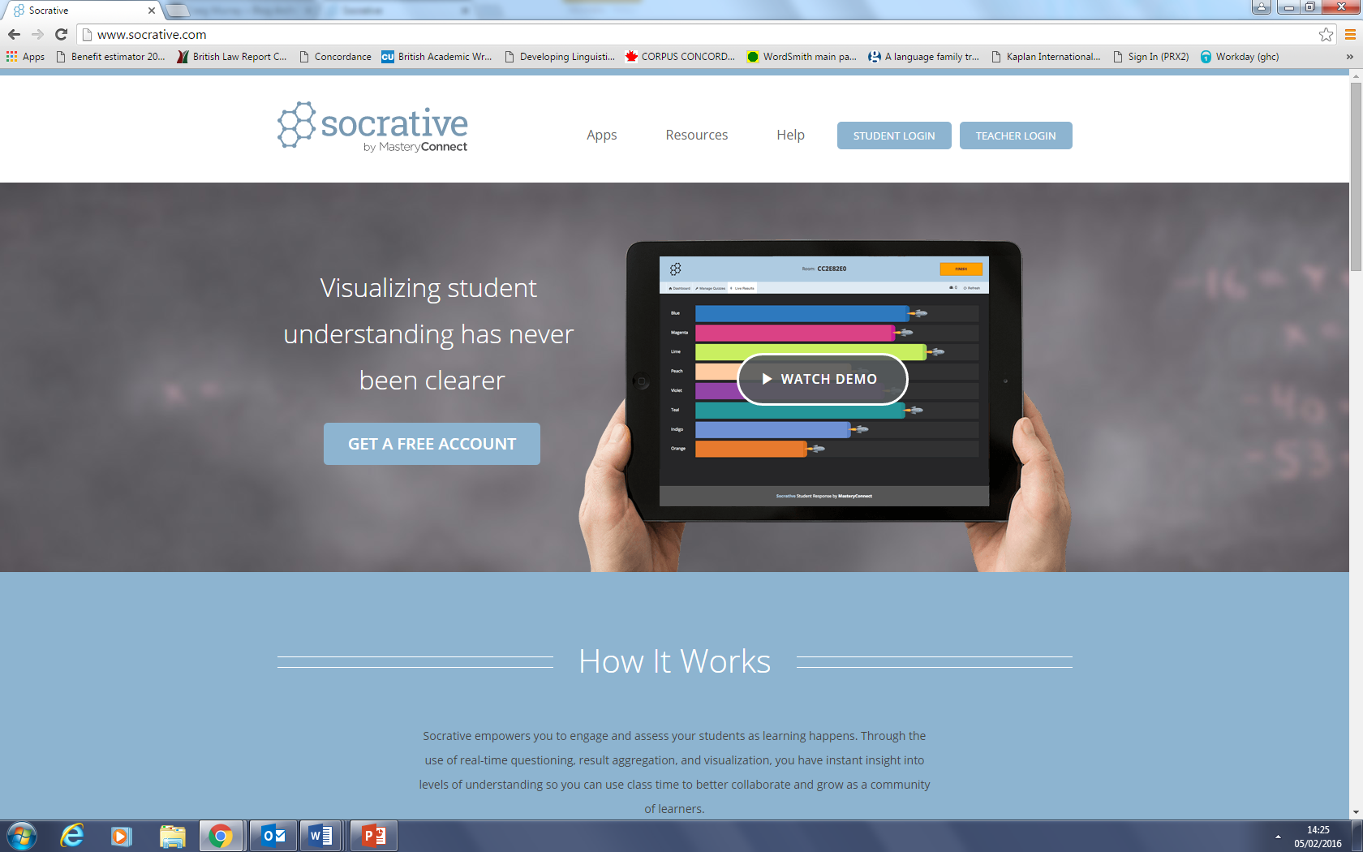
Context
Please use mobile device to go to socrative.com > student login > room SATORI
Tell me your ‘context’
What is MY CONTEXT?

Slide 3
My Context
Academic and professional background
Law - Information Science - Teaching
Current EAP context
General EAP; in-sessional LLM support; pre-sessional legal English; teach Pre-Masters Law

Slide 4
Student Context What do they want
Vocabulary
Challenges in ESAP teaching:
Cognitive overload. Over demand on working memory
Response.
"Cognitive load theory has been designed to provide guidelines intended to assist in the presentation of information in a manner that encourages learner activities that optimize intellectual performance”¹
In practical terms? Give students assistance with schema (cognitive architecture) and the vocabulary that helps construct it. But…
Do you know of good ESAP books that provide the vocabulary in a way that is linked to the discipline or subject architecture?

Slide 5
The four key prompts for what I’m coming to:
Psychology “Schemas may be cued by labels or by categorization based on salient features.” ²
Psychology & Memory – magical number 7 (Miller) ³
Cognitive Linguistics – semantic fields⁴
Language teaching & technical vocabulary learning – students want it but I think some of us shy away from it as ‘subject specialism’

Slide 6
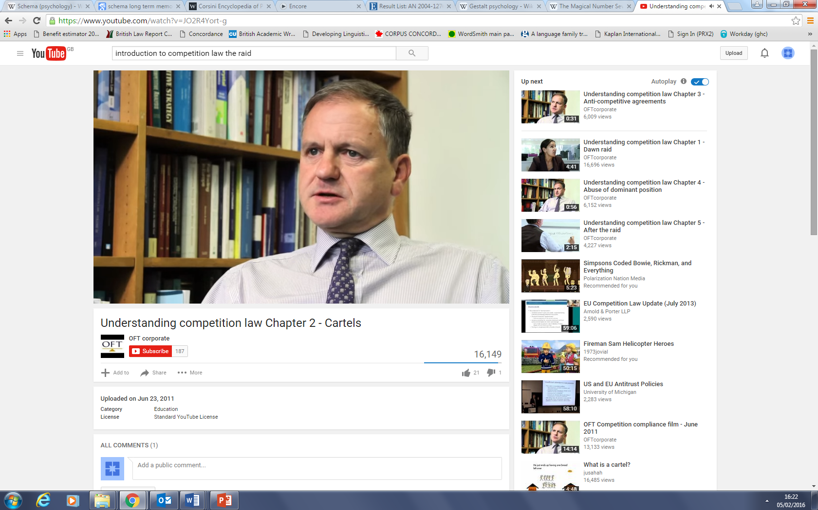
An example: law
Competition law – protection of consumers
Anti-competitive agreements [TFEU Chapter 1, Article 101]
Cartel
Price-fixing agreement
Bid rigging
(a number of competing businesses get together to say ‘let’s not compete’)

Slide 7
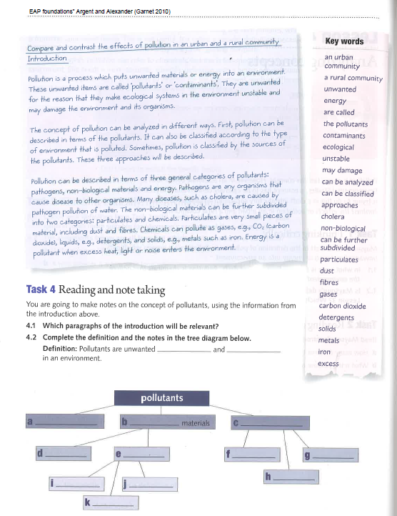
Access EAP Foundations Argent & Alexander 2010 Garnet

Slide 8
Your turn: create your own
What is a state according to this text from a Political Science & Law article?
SITUATING NATIONALISM IN AN AGE OF 'GLOBALIZATION'
There are a number of contemporary politico-legal challenges which presently exert themselves upon States, and which together call into question the very viability of the nation-State, at least in so far as the State is conceptualized to represent a 'Westphalian' model of absolute sovereignty. ¹² These 'challenges' are in fact rival sites of authority which in our time contest constructions of the nation-State as the pre-eminent, or according to certain positivists, the exclusive, site of territorial sovereignty; and which, in doing so, also offer alternative reference points for both the identity and the loyalty of the citizen. These rival sites of authority can be categorized in terms of 'levels', of which, a number of commentators agree, there are three. First, and in Europe at least the most topical, is the emergence of supra-state political and legal orders-most prominently the European Union. Although operating at the supra-state level, entities such as the EU remain territorial in their remit. For example, the EU has been described as a 'post-State' polity in that it operates above the State but remains a fully territory-based polity. ¹³ Certainly the EU is unique in terms of the sophistication of its institutional infrastructure, and other entities such as the North American Free Trade Agreement could certainly not be described as 'post-State'; however, even in the context of NAFTA, certain comparable issues concerning the transference of State sovereignty have arisen.

Slide 9
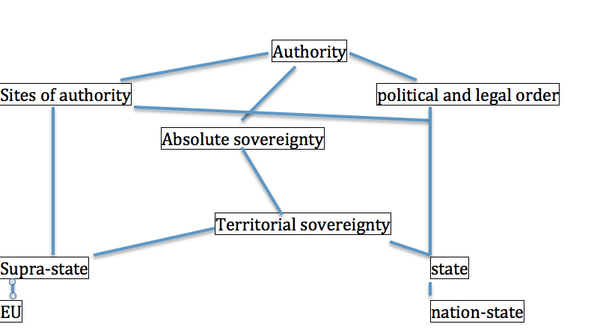
What is a state?

Slide 10
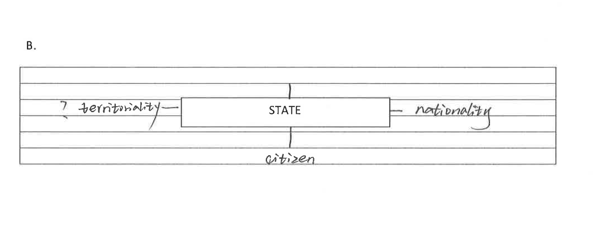
Student version

Slide 11
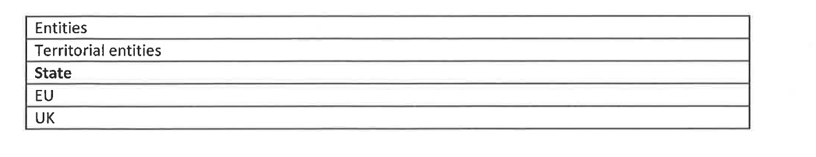
Law professor version

Slide 12
Answers
Possible definitions
Sovereignty is a concept within the domain of authority, is linked to political and legal order in the present context, and that a state is a territorial construct wherein sovereignty, a type of authority, sits.
A state is a site of authority or a political and legal order contained in a territory.

Slide 13
Conclusion
We can aid students (and ourselves) in
understanding concepts and content of the subject and
writing definitions
This can be done by choosing suitable sections of texts that provide the schema i.e. instead of ‘activating schema’ we are explicating schema.

Slide 14
Background reading (indicative)
Miller 1986 ‘The Science of Law’
Helsvig ‘ESP – Challenges for learners and teachers …’ https://ojs.kauko.lt/index.php/ssktpd/article/viewFile/99/96
Jean-Claude Viel The vocabulary of English for scientific and technological occupational purposes, http://www.esp-world.info/Articles_1/vocabulary.html
Tony Dudley-Evans, Maggie Jo St John Developments in English for Specific Purposes: A Multi-Disciplinary Approach
Chih-cheng Lin Semantic network for vocabulary teaching
Werry Rhetoric and reflexivity in cognitive theories of language
Aitchison 2003 Words in the Mind

Slide 15
References
Sweller, J., Van Merriënboer, J., & Paas, F. "Cognitive architecture and instructional design". Educational Psychology Review 10 (3) 1998, pp251–296.
Fiske, Susan T.; In: Encyclopedia of psychology, Vol. 7. Kazdin, Alan E. (Ed); Publisher: American Psychological Association; 2000, pp. 158-160

Slide 16
References
3. Miller, G. A. (1956). "The magical number seven, plus or minus two: Some limits on our capacity for processing information". Psychological Review 63 (2): 81–97.
4. Carroll, “Psychology of Language" Cengage Learning, 2007

