Slide 1
Jill Haldane
English Language Education, Office of Lifelong Learning, University of Edinburgh

Slide 2
This idea needs re-expressing
Linguistic variation in EAP feedback on ESP academic writing
Notes:
When the borders of EAP are expanding, the consideration today is learning from and developing teachers’ practice . The interface of content and language is exemplified in the context of ESP, and, as a linguist and a teacher, the basis for insightful research into linguistic variation in the feedback genre. I have focussed on the demonstrative pronoun ‘this’ as a discourse feature in both settings, content and language, with interesting results.

Slide 3
The English teacher may be unwittingly cooperating in the process of marginalisation with a view of the role only as language teacher.
…embrace and be prepared for the constant possibilities for change.
Gee, 1990:68
The challenge to the English teacher
Notes:
Sociolinguist James Gee claims that we must embrace change, and ESP as a context is the ideal situation for EAP teachers to comment extensively on content as well as language. When we analyse the discourse in content and language-based feedback, are we adapting to change?

Slide 4
Presentation Overview
Purpose and Aims
4 Research Questions
EAP Register Study – background to ESP context
Examples of ‘this’ in content and language-based comments
Methodology – CDA
Findings
  ‘this’ in speech acts;
  frequency of ‘this’ in types of comments
  Teachers’ individual practice
Conclusion
Implications
Q n’A
Notes:
My presentation today will begin with an introduction that covers the purpose and aims of my research. Then I will outline the research questions underpinning my study, before moving on to the background to my study and key concepts of analysis. Following that, the findings about the use if this in content-based and language-based settings will be presented and I will end with my conclusions and implications for practice

Slide 5
INTRODUCTION
Purpose
EAP tutors’ register when giving feedback on an online ESAP academic writing course at UoE
Aim
with CDA, analysing discourse variations in content and language tells us about EAP teacher practices
Notes:
My purpose today is to look at EAP tutors’ register when giving feedback on an online ESP academic writing course at English Language Education, UoE because I think when we look at.

Slide 6
Why linguistic variation in feedback?
What you are doing
Who you are being
Mirror – discourse and identity are both shaped and shaping
Social practices of English teachers can be transforming and transformative
How adaptive are we to changes in our field?
doing being’ a teacher
Notes:
So, what teachers are doing and who they are being when they are doing it results in ‘doing-being’ a teacher. Like a mirror, as discourse reflects the teacher’s identity back onto herself while doing-being a teacher, the teacher recognises herself in her discourse, hence a simultaneous shaping of the the individual practitioner and her discourse. As we know, our practices as English teachers have the power to transform, so establishing a hypothesis about using ‘this’ could tell us to what extent we are adapting of practices to changes in our field.

Slide 7
Research Questions
Did EAP tutors give feedback on content as well as language?
Did the feedback vary?
Were linguistic variations particular to language and/or content comments?
What can linguistic variation tell us about EAP practice in a diverse fields?
Notes:
So, in order to achieve this aim, I will investigate four guiding questions.

Slide 8
Types of content-based comments
Structural coherence: “If this is one of your key points, you should develop it fully in a separate paragraph.”
Argument: “You need to back up this point you make with evidence.”
Citing/Referencing: “This is a new reference, so it should be on another line.”
Topic: “Are you saying relativism is to embed one’s culture into others??”
Notes:
For the purpose of this study, I have defined content as engagement with the topic or substance, such as citing, using evidence, supporting points, argumentation and rebuttal of counterarguments. I also view content as underlying structure.

Slide 9
Types of language-based comments
Grammar: “No article for uncountable nouns used in general.”
Word choice: “‘Different’ means ‘dissimilar’ or ‘not the same’, but I think you mean ‘various’ or ‘several’ or ‘a range’.”
Cohesion:“ ‘Whereas’ links ideas within a sentence.”
Semantic clarity: “This really does not make the meaning clear.”
Notes:
Language is broadly categorised for me as lexico-grammatical items, including punctuation and syntax; also, surface structures, language frames and signals that create cohesion. In short, Language as the packaging of meaning,

Slide 10
ESP context
Social and Political Science (SPS) Academic Writing online course in Term 1 at UoE
5 weeks of course materials
  Structuring an essay
  Reading and Writing Critically
  Citation and referencing
  Concluding
  Revising and editing
Self-study on LEARN
Submit final essay to SPS tutor
  Human rights
  Millenium Development Goals
  Concept of the nation state
  Democracy and the welfare state
  Political and monetary union on Europe
Notes:
I chose a school-tailored, ESP academic writing course offered in Term 1 at UoE for the School of Social and Political Science (SPS). The students work independently through 5 units of work without F -2-F contact with tutors. The course covers stages and structural elements of writing as well being critical and using source materials. They submit a weekly writing task via LEARN, the UoE virtual learning environment. Finally, they submitted their essay – on one of five topic choices - to the SPS tutor.

Slide 11
Feedback guidelines for EAP teachers
Comment on academic expectations
  Answering the question?
  Balance of arguments?
  Expressing an argument/making a knowledge claim and using sources to support/critique it?
  Evaluation by way of following up on the argument?
Comment on effective/ineffective paraphrasing and summarising.
Comment on writing style and use of non-academic language.
Comment on organisation and paragraphing.
“The separation of language from content creates a false dichotomy and it is clearly important not to lead students to view the two as separate as this may lead to rhetorical inappropriacy”
Notes:
So guidance from the CD on feedback to SPS students is clearly inclusive of content and academic literacy, while reminding EAP teachers of the false dichotomy around distinctions between language and meaningful expression of ideas.

Slide 12
Details of the study
2015 – 11 staff giving feedback
Two female EAP teachers chosen at random
  Teacher A -ESOL, EGAP background
  Teacher B – Phd, EGAP, ESP background
Feedback on Unit 1 analysed
  Teacher A – 6 students
  Teacher B -7 students
  280 comments in 179 comment texts over 13 matrix texts

Slide 13
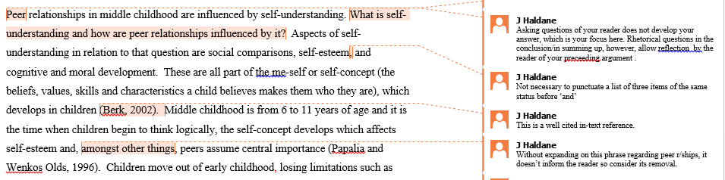
Tracked Changes review tool
EAP tutors give weekly feedback via LEARN
Microsoft Office Tracked Changes review tool
Comment text
Matrix text
Notes:
The register study was the fufillment of a very broad remit of my masters programme to take any aspect of Applied Linguistics and do some original research. I was specialising in discourse analysis, so I was always going to focus on linguistic practice. Then, while giving feedback about writing to a PG student on an online course, I realised I had used the demonstrative pronoun, ‘this’, successively, and I wondered why I was phrasing my comments in such a way. So it made me stop and think about my practice and then I wondered if others used it as frequently as me. So I wanted to investigate ‘this’ as a discourse feature of in the genre of writing feedback and to analyse the linguistic variation between EAP tutors to observe any salient patterns of use that could inform my practice and the wider cohort at ELE.

Slide 14
Linguistic variation - Deixis
Demonstrative pronoun, ‘this’
Levinson (2006)
Contextually-dependent reference in language and non- verbal communication
1.ESP/EAP & language/content - context cross-over
2. Is EAP linguistic variation accountable due to crossing over into ESP field?
Notes:
So I was looking for deixis in EAP feedback, specifically the demonstrative, ‘this’ because as contextually-dependent references in language, it require semantic understanding of the place, time and speaker intention, says the pragmatist, Levinson (2006). This was ideal for my purpose because I was investigating EAP linguistic practice in EAP context: a contextual interface where questions about what content is very obviously merges with those about language.

Slide 15
CDA- Intertextuality - Ideology
Critical Discourse Analysis (CDA)
  “The role of power relations in social institutions as ideologically shaping how language is used in them.” Hyland, 2000:156
All texts are representative of other texts – sociocultural relations and change Fairclough, 1995
“just as types of discourse in certain settings are invested with ideology they may also be reinvested, or reproduced”
  Frow, 1985; Fairclough, 1992
social agents can act creatively to reposition their practices and reconstruct the discourse. Fairclough, 1992.
Notes:
The methodological approach I used was Critical Discourse Analysis or CDA and I have used Hyland’s definition here because he is talking about the shaping of discourse through institutional practices. CDA views all text as representative of aspects of other texts from other social beings and this can tell us a significant amount about sociocultural processes, relations and change. For example,
CDAist like Norman Fairclough 1992 and Frow 1985 also recognised that just as types of discourse in certain settings are invested with ideology they may also be reinvested, or reproduced. If we think about international PG students, and their socialisation into the academic community, then we might consider the acquisition of academic literacy as a reproduction or reinvestment of ideological discourse as the students go on to successfully apply learnt behaviours in their academic communities. In summary, then, Fairclough believes ideology as dynamic so that social agents have the act creatively to reposition their practices and reconstruct the discourse.

Slide 16
Examples of ‘this’ in content-based comments
Are you referring to human rights? Also why mention this here.
Is this direct quotation?
If you are going to start this, then it should be at the start of a new paragraph
This is not just a reference to the past situation but also to the current state of affairs.
Notes:
So, how did teachers use the demonstrative pronoun, ‘this’ in comments about content? Here are some examples, and note that on these instances, we are looking as ‘this’ as a determiner.

Slide 17
Examples of ‘this’ in language-based comments
Break this up into 2 or 3 different sentences.
You need to rewrite this sentence
This appears to be an incorrect word choice
This sounds a bit strange.
You should check the meaning of this word.
Notes:
Likewise, language-based comments also used deixis in a similar way, but note examples 2 and 5 use ‘this’ as a demonstrative adjective. So we can observe the linguistic feature in the register,

Slide 18
Teacher Comment 1: What does it mean?
“Present Simple”
You have used the wrong tense, so use present simple tense.
Notes:
So the first example, what does this mean? [Elicit from the audience] So quite clear based on what we as EAP practitioners know about language. Let’s look at the second one – clear based on shared knowledge or requiring situational clues?

Slide 19
Teacher Comment 2: What does it mean?
“The plural is ‘phenomena’.”
You have used the wrong word form for more than one phenomenon, so use ‘phenomena’ instead.
Notes:
What does this mean? [Elicit from the audience] Great, so again, it’s clearly a word form error and the teacher is informing the student about the correct form of the word – so again, clear enough to this audience

Slide 20
Teacher Comment 3
“This is too long and clumsy for a single sentence.”
There is something wrong with ‘this’, but what is ‘this’?
“The single sentence: ‘……….’ is too long and clumsy.”
“This sentence is too long and clumsy.”
Notes:
Finally, how clear is this comment to us? Can we draw on our expert language knowledge to make sense of this? Well, there are no metalinguistics here? Yet, we know that ‘clumsy’ is not good for syntactic clarity, but what exactly is wrong with ‘long’? It’s not clear to us sitting here.. In short, we had to be there to get the punchline. So comment 3 is an example of deixis – and clear understanding of what ‘this’ means is dependent on the situation or context, to which we are currently not party.
The reason comment three is not clear is because we, the conference audience, cannot see the original script that contains the student’s work, and it is necessary to see what ‘this’ refers to. It’s clear that just as the feedback wouldn’t exist without the student’s writing, ‘this’ necessarily refers to a linguistic item in the matrix text explicitly manifest to the speaker (the teacher) and the hearer (the student ) and does not reference outside of the matrix text. In this small way, teacher comment three can be said to centre on the interaction between that teacher and that student on that particular unit of the student’s work. Adopting linguistic choices of deixis could be said to invoke an interpersonal dialogue, just like two interlocutors in a conversation. But what if the comment was: “The single sentence: ‘……….’ is too long and clumsy, “ Still manifestly referent to the matrix text due to the student’ quote, but there is no tendency towards dialogue here because this sentence stands alone in the third person for everyone to understand. Compare it to “ This single sentence is too long and clumsy.” Now we understand the subject with ‘this’ is a determiner, so manifestly referent to the student’s work but which sentence? Only teacher and student are party to that.

Slide 21
Types of assertive speech acts
Evaluating
Informing
Correcting
This needs an article ‘an’
In my opinion, the functions and contributions of the state have not been sufficiently considered
This point can be rephrased more succinctly and elegantly
This sounds somewhat conversational in style
‘remaining’ means ‘leftover’!
‘Forces’ is plural!
Compound noun ‘party politics’
Use a more hedged verb e.g. ‘argue’
‘do not suffice’
‘Has weakened’
‘all-encompassing’
Despite losing
Notes:
Turning now to the findings, it is interesting that there were twice as many assertive acts as directive acts in feedback. Of those asserted statements, I have classified comments as informing, correcting and evaluating, and here are some examples of these types of acts. So the teachers asserted statements of truth or falsity and their reasoning significantly more than they made direct requests or demands of the student.

Slide 22
Assertives using ‘this’
Notes:
.. Looking at linguistic variation, it is very clear that the teachers used ‘this’ exclusively when making evaluative assertions. They never use ‘this’ for corrections and making information statements. Given that Hyland and Hyland 2001 discuss teacher feedback as a delicate, social interaction between teacher and student, could using ‘this’ be a mitigation strategy? BY using ‘this’ is manifestly explicit reference, which is direct. H & H says that mitigation is indirect and open to misunderstanding – students may be confused and disillusioned. So teachers’ directness is a positive practice in feedback.

Slide 23
Feedback on content & language
Notes:
Now let’s move on to the findings of the study that looked at 280 instances of comments in 179 comment texts in response to 11 matrix texts. In answer to research question one, I noticed that the two EAP tutors did make comments about content such as topic, argumentation and underlying structure, but they were not disposed to making those types of comments.

Slide 24
Findings on RQ 1
Did EAP tutors give feedback on content as well as language?
Yes, but EAP tutors made four times more language-based comments than content-based ones.

Slide 25
All feedback comments using ‘this’
Notes:
Addressing the second research question now about linguistic variations, I discovered this interesting statistic on the use of this’ in feedback. While this chart does index a pattern of use of demonstrative ‘this’ in the genre, the tendency to do so for Teacher A and B collectively.
– at less than 40% - could be roughly described as more than incidental but less than commonplace.

Slide 26
Findings of RQ 2
Did the feedback vary?
Yes, they used demonstrative ‘this’ in both content and language comments, which is accountable.

Slide 27
Content & language comments using ‘this’
Notes:
Research question three pertained to linguistic variations in comments about either language or content. I have shown in this chart the collective tendency to use ‘this’ by both Teacher A and B.
Of all content-based comments, 79% (42/53x100) use ‘this
Of all language-based comments, 30% (68/227 x 100) use ‘this’

Slide 28
Findings of RQ 3
Were linguistic variations particular to language and/or content comments?
Yes, EAP tutors used ‘this’ 2.5 times more commenting on a content-based item than on a language-based item.
Notes:
So with 2.5 times more comments …….it is accountable. There is a clear possibility that as engaging with ESP content is highly contextualised, it makes sense to be explicitly manifest about your assertions in feedback. But the question still remains: if linguistic variation has altered the discourse on content, what does that tell us about EAP teachers’ practice. In other words, why is ‘doing being’ a teacher giving feedback on content different than ding being a teacher on language?

Slide 29
Findings of RQ 4
What can linguistic variation tell us about EAP practice in a diverse fields?
Nothing evidential because the data set is too small. But we can observe assertive statements in feedback as well as direct and dialogic acts.

Slide 30
Teachers A & B – comparative analysis of ‘this’
Notes:
With my small-scale data set, it appears that when we analyse the teachers’ practices individually, there seems to be an inclination both by Teacher B and by Teacher A to use ‘this. ’ But this tendency is to differing extents - exceeding 40% for B and 10% or less for A. Nonetheless, Teacher A and B vary to consistently similar extents in each type of comment, content and language. There is only a marginal difference in the frequency of using ‘this’ for content and for language. In other words, it is indicated by their consistent discourse that neither Teacher A not Teacher B recognise content-based commentary as requiring different discourse way of being than when commenting on language.

Slide 31
Teachers A & B – comparative data on Script 1
Teacher A used twice as many comments as Teacher B
TEACHER A | TEACHER B
omit | Can you try to rephrase this a little better? | 1
Do you mean ‘diffuse’? | You need to make this clearer. In what sense is cultural imperialism based on relativism? | 2
It might be clearer to use a passive construction here with ’the notion’ as the subject | Meaning unclear. Are you saying relativism is to embed one’s culture into others?? | 3
‘all-encompassing’ | Sentence structure. This is not a full independent sentence. | 4
Try ‘is constantly felt’ | Unclear | 5
One of these will do! | You have not made your meaning clear | 6
Change the tense here. | Is this correct | 7
Again. it might be clearer to use a passive construction here with ’the world’ as the subject. | This is too long and clumsy for a single sentence. Break this up into 2 or 3 different sentences. | 8
This sounds odd. Try the phrase ‘global village’. | Explain the reasons underlying these arguments. | 9
Who are ‘them’? | Finally | 10
This phrase is used for physical appearance. Use the adjective ‘an apparent withering’. |  | 11
No article for uncountable nouns used in general |  | 12
‘emerges’ |  | 13
‘Phenomena’ will do here! |  | 14
Do you mean ‘with the result that’? |  | 15
behind |  | 16
‘examining’ |  | 17
And, But and Because link ideas within the same sentence. |  | 18
The plural is ‘phenomena’ |  | 19
Do you mean themselves or each other? |  | 20
Teacher B used half as many comments as Teacher A
10% of Teacher A’s comments contain ‘this’ & are all language-based
50% of Teacher B’s comments contain ‘this’ and 33% are content-based
Notes:
In support of this understanding, we should look no further than Script 1 of the respective teachers A and B. The table highlights the individual differences between Teacher A and Teacher B’s approach to giving feedback to one of their students. There are 20 comments for A and half that for B. Is B a lazy teacher? Or is she considering the student’s needs in feedback, relative to the task, the source materials and the student’s response? Teacher A makes no content-based comments at all compared to around a third by Teacher B. Again, is there nothing for A’s student to learn about content? Argument? Coherence? Citations?

Slide 32
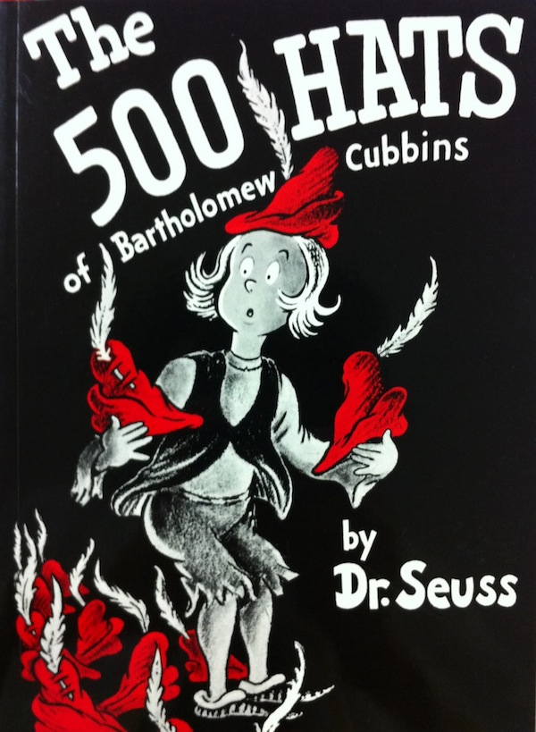
Hats we wear as teachers
Teacher B is five times as disposed to using ‘this’ as Teacher A.
A facilitator of guidance about essays?
An expert in the academic writing genre?
An assessor of language use?
An instructor of correct rules?
An enthusiast in the topic field?
A fellow social agent support student’s socialisation?
A reader of an argument to be analysed?
A human source of referencing information?
An interlocutor to engage in a dialogue about social science?
Notes:
Teacher B is five times as disposed to using ‘this’ as Teacher A. To use an analogy from Dr Seuss, The 500 Hats of Bartholomew Cubbins, I could explanation that Teacher B is putting on her feedback hat whereas A is putting on an English teachers hat. Of course, it all comes down to how we view ourselves as social beings in this act. A facilitator of guidance about essays? An expert in the academic writing genre? An assessor of language use? An instructor of correct rules? An expert in the field of content? A fellow social agent to support student’s socialisation?? A reader of an argument to be analysed? A human source of referencing information? Or, perhaps, an interlocutor to engage in a dialogue about social science.

Slide 33
Conclusion
My data sample of 2 EAP tutors too small to discuss EAP practice in the genre of giving feedback ☹
Teacher A & B’s similar difference in linguistic variation ☺
Teacher B using ‘this’ equitably in certain settings shows she is not doing-being a teacher, but she is doing-being giving feedback
Notes:
ESP may be a rich context to investigate EAP tutors’ feedback on content as well as language, but the analysis in my small study returned unremarkable data. No doubt the data sample of two is too small for significant discussion. The most interesting finding for me is Teacher A & B’s similar difference in linguistic variation . For instance, Teacher B is influenced by her membership of the academic community, both personally and professionally. She is aware of the value of her position in it and the similar aspirational intent of the student. She is also aware that separating form from function is an artificial notion. In short, her linguistic practices are a result of her understanding the social practice in which she is engaged. Based on CDA approaches to ideology in discourse, Teacher B using ‘this’ quite equitably in certain settings shows she is not doing-being a teacher, but she is doing-being giving feedback - she is performing socially in her linguistic practice, which includes awareness of conventions and the possibilities for innovation within them.

Slide 34
Genres may change from the inside, from the small acts of individuals giving expression to their intentions using innovative forms within the boundaries of generic convention
Hyland, 2000: 173
Implications for change
Notes:
My small-scale but insightful data appears to support a tendency by current practitioners in EAP to be adaptive to change. If we take Hyland’s claim on board , we might view the two teachers’ linguistic variation as small acts of an individual to innovate within the conventions of their academic communities. We may see more AW feedback that is direct, explicictly manifest, assertively evaluative and dialogic. In other words, we might see innovative change to the genre of gving feedbcak.. Rurther research into other contexts of register such as online/ f-2-F as well as a wider data set of EAP teacher is required to extent this early insight into the transformative power of EAP discourse when crossing bondaries.

Slide 35
REFERENCES
Fairclough, N., 1992. Discourse and social change. Cambridge, UK: Polity Press.
Fairclough, N., 1995. Critical discourse analysis. NY: Longman.
Frow, J., 1985. Discourse and power. Economy and Society, 14
Hyland, K., 2000. Disciplinary discourses: Social interactions in academic writing. Essex, UK: Pearson Education Ltd.
Hyland, K., 2003. Second language writing. Cambridge, UK: CUP
Gee, J.P., 1990. Social linguistics and literacy: Ideology in discources. London: Falmer Press.
Levinson, S.C., 2006. Deixis. In: L.R. Horn and G.L.Ward. Handbook of pragmatics. Oxford: Blackwell Publishing, Ch.5.

